Slide 1
Plant responses to temperature over space and time
February 12, 2019

Slide 2
Class questions
How does temperature change in natural environments?

Slide 3
Class questions
How does temperature change in natural environments?
Why does temperature variation matter for plants?

Slide 4
Processes that respond to temperature: Enzymatic potential

Slide 5
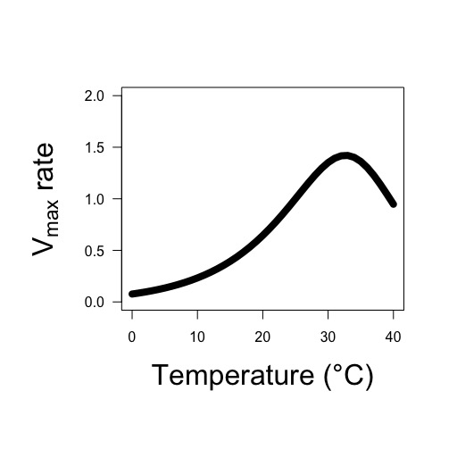
Enzyme rate (Vmax) is the result of both the activation rate and deactivation rate
Leads to a peaked exponential response

Slide 6
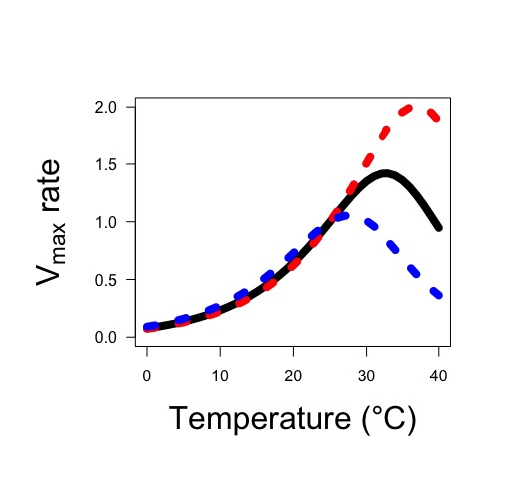
This peak may change based on acclimation
Red = warm acclimated
Blue = cold acclimated

Slide 7
Processes that respond to temperature: Substrate affinity

Slide 8
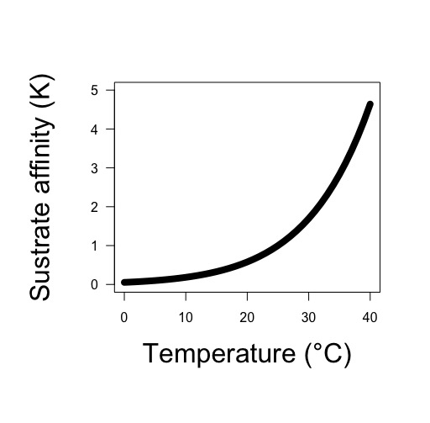
Substrate affinity increases with temperature
The change is dependent on the substrate and enzyme

Slide 9
Processes that respond to temperature: Diffusion

Slide 10
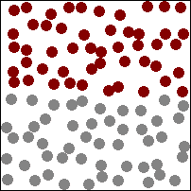
Diffusion: movement from area of low concentration to high concentration

Slide 11
Diffusion rates increase with temperature (Fick’s law coefficient increases)

Slide 12
Class questions
How does temperature change in natural environments?
Why does temperature variation matter for plants?

Slide 13
Respiration and temperature

Slide 14
Respiration and temperature
Enzymatic rates increase with T
Substrate affinity increases with T

Slide 15
Respiration and temperature
Enzymatic rates increase with T
Substrate affinity increases with T
What should the response look like?

Slide 16
Photosynthesis and temperature

Slide 17
Photosynthesis and temperature
Enzymatic rates increase with T
Substrate affinity increases with T

Slide 18
Photosynthesis and temperature
Enzymatic rates increase with T
Substrate affinity increases with T
What should the response look like?

Slide 19
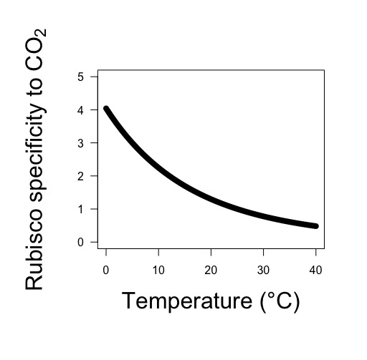
Photosynthesis and temperature
Enzymatic rates increase with T
Substrate affinity increases with T
Rubisco likes O2 more at higher T!

Slide 20
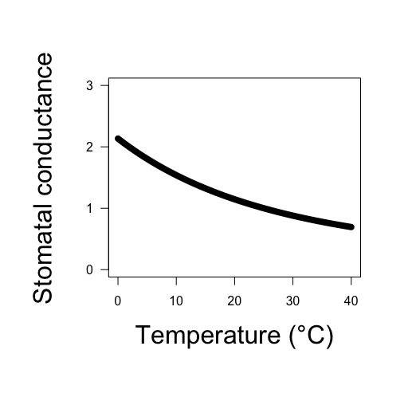
Photosynthesis and temperature
Enzymatic rates increase with T
Substrate affinity increases with T
Rubisco likes O2 more at higher T!
Stomata close at higher T!

Slide 21
Photosynthesis and temperature
Enzymatic rates increase with T
Substrate affinity increases with T
Rubisco likes O2 more at higher T!
Stomata close at higher T!
What should the response look like?

Slide 22
Photosynthesis and temperature
Enzymatic rates increase with T
Substrate affinity increases with T
Rubisco likes O2 more at higher T!
Stomata close at higher T!
Would this differ for C4 species?

Slide 23
Transpiration and temperature

Slide 24
Transpiration and temperature
Diffusion rates increase with T

Slide 25
Transpiration and temperature
Diffusion rates increase with T
What should the response look like?

Slide 26
Transpiration and temperature
Diffusion rates increase with T
Stomata close with increased T!

Slide 27
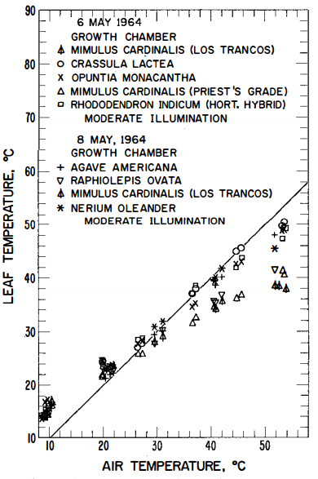
Transpiration and temperature
Diffusion rates increase with T
Stomata close with increased T!
Leaves cool with increased T!
Gates (1968)

Slide 28
Transpiration and temperature
Diffusion rates increase with T
Stomata close with increased T!
Leaves cool with increased T!
What should the response look like?

Slide 29
But now what about acclimation!

Slide 30
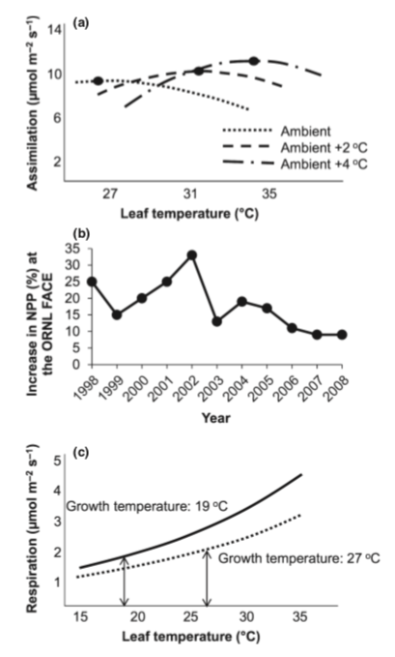
Acclimation leads to a roughly homeostatic response!
Gunderson et al. (2010)
Silim et al. (2010)

Slide 31
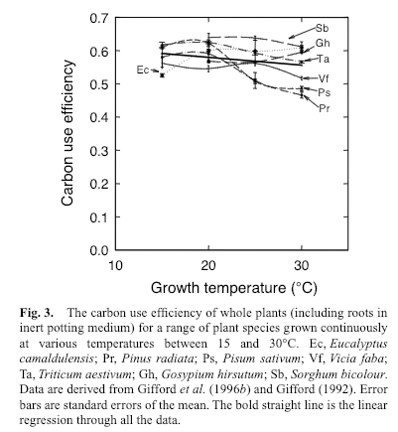
CUE = photosynthesis / respiration
Gifford (2003)

Slide 32
Class questions
How does temperature change in natural environments?
Why does temperature variation matter for plants?
Does any of this even matter?

Slide 33
Will a 3-5°C increase in temperature matter? Why or why not?
IPCC (2013)

